Slide 3
CHAPTER 16
Virtualization

Slide 4

Introduction
In the 1960s, the computing community was frustrated by the problem of sharing resources (such as memory, disk and I/O channels) on one physical machine among several independent applications.
Virtual machines and, later, containers emerged to deal with sharing.
The goal of these virtual machines and containers is to isolate one application from another, while still sharing resources.
Why is this topic of concern to architects?
As an architect, you may be required to use some form of virtualization to deploy the software that you create.
For an increasingly large set of applications, you’ll be deploying to the cloud and using containers to do it.

Slide 5
16.1 Shared Resources
There are four resources that we typically care about sharing:
Central processor unit (CPU)
Processor sharing is achieved through a thread-scheduling mechanism.
The scheduler selects and assigns an execution thread to an available processor.
Memory
Virtual memory allows apps to use more memory than physically available. Memory is split into pages and swapped in/out of disk.
Each app thinks it has its own memory, keeping apps isolated from each other.
Disk storage
Disk access is controlled using a disk controller and OS-level permissions. Threads and files are tagged with user/group IDs, and access is allowed or blocked based on these tags to maintain isolation.
Network connection
Every virtual machine or container has an IP address.
Every message intended for a service has a port number associated with it.

Slide 6
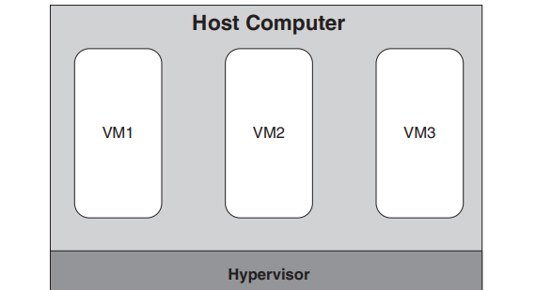
16.2 Virtual Machines
Virtual machines allow the execution of multiple simulated (or virtual) computers in a single physical computer.
The physical computer is called the host computer and the VMs are called guest computers.
A hypervisor is a piece of software (or firmware) that allows multiple VMs to run on a single physical computer by virtualizing the hardware.
This picture shows a hypervisor that runs directly on the physical computer hardware and is often called a bare-metal or Type 1 hypervisor.
Bare-metal hypervisors typically run in a data center or cloud.

Slide 7
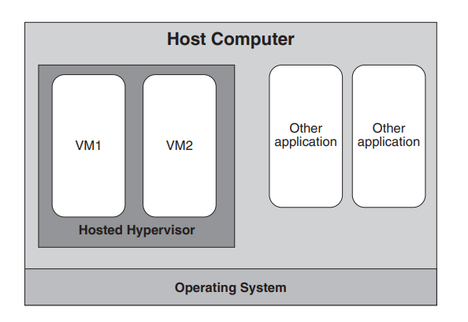
16.2 Virtual Machines
Another type of hypervisor, called a hosted or Type 2 hypervisor. In this case, the hypervisor runs as a service on top of a host operating system, and the hypervisor hosts VMs.
Hosted hypervisors are typically used on desktop or laptop computers.
They can be used to replicate a production environment on a development computer. This approach ensures that the development and production environments match each other.

Slide 8
16.2 Virtual Machines
A hypervisor performs two main functions:
It manages the code running in each VM
it manages the VMs themselves
The hypervisor is a complicated piece of software. One concern with VMs is the overhead introduced by the sharing and isolation needed for virtualization.
That is, how much slower does a service run on a virtual machine, compared to running directly in a bare-metal physical machine?
Virtualization technology is improving all the time, but overheads of approximately 10% have been reported by Microsoft on its Hyper-V hypervisor.
VMs have two important effects that software architects need to consider:
Performance: Virtualization incurs a performance cost.
Separation of concerns: Virtualization lets architects focus on design, while others handle hardware and deployment.

Slide 9
16.3 VM Images
A VM image is like a copy of a computer’s hard drive. It contains all the data and programs needed to run a virtual machine, including:
The operating system
Software/services you want to run
The boot loader, which is the small program that starts the system.
There are three approaches you can follow to create a new VM image:
You take a copy (snapshot) of a computer that’s already set up the software you need.
You can start from an existing image and add additional software.
Build from scratch: install the OS, format the disk, add software, etc.

Slide 10
16.3 VM Images
For the first two approaches, repositories of machine images are available that provide a variety of images. For example:
Minimal images with just OS kernels.
Other images that include complete applications.
However, some issues may arise when you running an image that you did not create:
You cannot control the versions of the OS and software
The image may have software that contains vulnerabilities or that is not configured securely.
Even worse, the image may include malware.

Slide 11
16.4 Containers
VM images are large (e.g., 8 GB), and even over fast networks, transferring them takes time (several minutes). After transfer, booting the VM also adds delay.
Containers are a mechanism to maintain most of the advantages of virtualization while reducing the image size and startup time.
Here is the difference between VMs and containers:
VMs
share the same hardware
have their own OS
use hypervisor for hardware virtualization
Containers
share the same hardware
share the same OS
use container runtime engine for OS virtualization

Slide 12
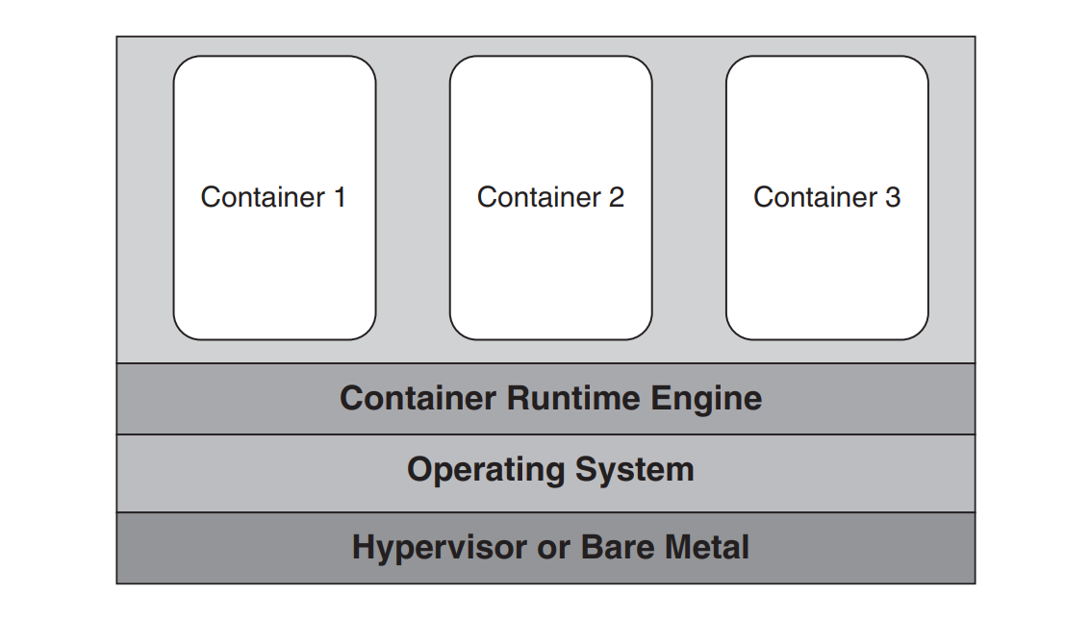
16.4 Containers
The operating system can be loaded either onto a physical machine or a virtual machine. This figure shows containers running on a container runtime engine running on an operating system running in a VM under the control of a hypervisor.

Slide 13
16.4 Containers
This sharing of the operating system represents a source of performance improvement when transferring images.
The second source of performance improvement is the use of layers in the container images. To better understand container layers, we describe how a container image is constructed to run the LAMP stack. (Linux, Apache, MySQL, PHP)
Create a container image containing a Linux distribution.
Execute Linux image and use it to load Apache in a second image.
Execute Apache image and load MySQL as a third image.
Repeat this process one more time and load PHP.
Now if you update PHP to a newer version and move the revised stack into production. The container management system moves only the PHP layer of the image.
However, If you wanted to update MySQL, both MySQL and PHP would be updated.

Slide 14
16.5 Containers and VMs
Virtual Machine properties:
A VM includes a full operating system so you can run almost any operating system.
You can also run almost any program in a VM which is important when working with legacy or purchased software.
Having the entire operating system also allows you to run multiple services in the same VM, a desirable outcome when the services are tightly coupled or share large data sets.
Containers properties:
The operating system must be compatible with the container runtime engine, which limits the software that can run on a container.
Size of the container image is small, including only those programs and libraries necessary to support the service we want to run. containers generally run a single service.
As we will see shortly, we can group containers running related services so that they will execute on the same physical machine and can communicate efficiently. Some container runtime engines even allow containers within a group to share memory and coordination mechanisms such as semaphores.

Slide 15
16.6 Container Portability
We have introduced the concept of a container runtime manager with which the container interacts.
Several vendors provide container runtime engines, most notably Docker, containerd, and Mesos.
The interface between the container runtime engine and the container has been standardized by the Open Container Initiative.
So, a container created by one vendor’s package (say, Docker) to be executed on a container runtime engine provided by another vendor (say, containerd).
This means that you can develop a container on your development computer, deploy it to a production computer, and have it execute there.

Slide 16
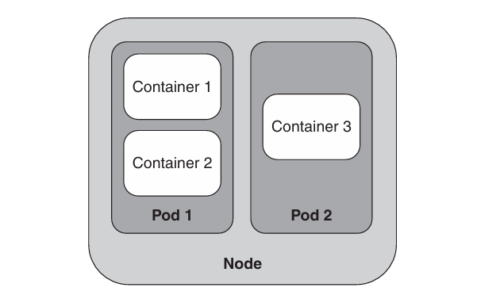
16.7 Pods
Kubernetes is open-source orchestration software for deploying, managing, and scaling containers.
Kubernetes has one more element in its hierarchy: Pods. A Pod is a group of related containers.
In Kubernetes, nodes (hardware or VMs) contain Pods, and Pods contain containers.
The containers in a Pod share an IP address and port space to receive requests from other services.
They can communicate with each other using mechanisms such as semaphores or shared memory.
They have the same lifetime (the containers in Pods are allocated and deallocated together).
The purpose of a Pod is to reduce communication costs between related containers.

